Slide 1

Python
A language for the modern developer
Presented by: Dakota Cookenmaster & Michael yoon

Slide 2
Paradigms & categories
Functional
Imperative
Object-oriented
Procedural
Used for Scripting
Byte-code Interpreted
Dynamically-typed
Managed Memory

Slide 3
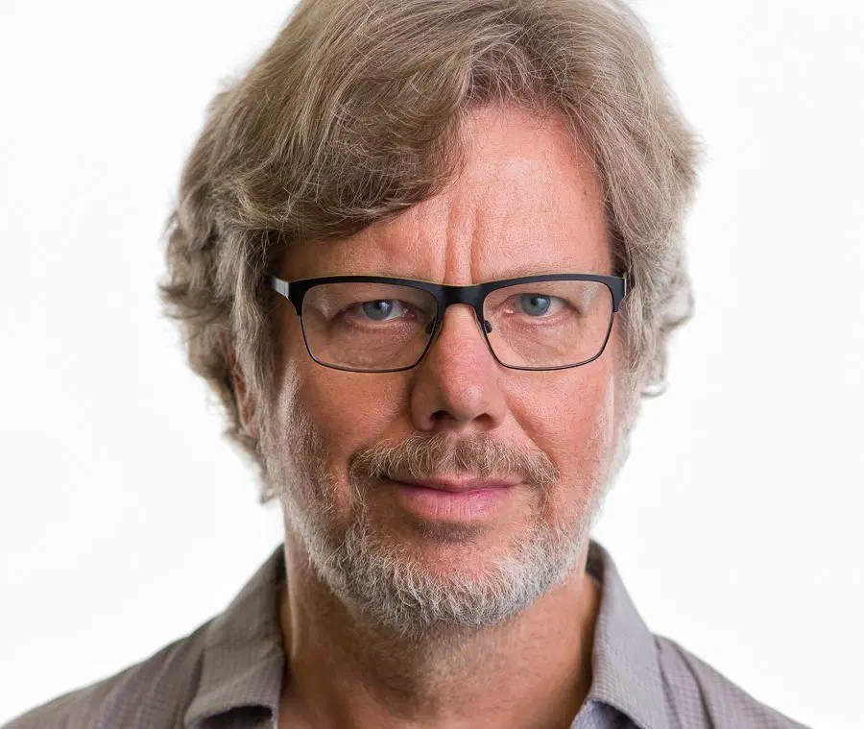
History
Created by Guido van Rossum and released February 20, 1991
Name comes from BBC TV sketch series, Monty Python’s Flying Circus
Was solely the idea of Van Rossum
https://pythoninstitute.org/what-is-python/

Slide 4
Core Features
Built-in Types:
Boolean Operations:
and, or, not
Numeric
int, float, complex
Sequence Types
list, tuple, range, str
Built-in Functions and Constants
abs(), bool(), chr(), dir(), hash(), map(), etc.
True, False, None, NotImplemented, Ellipsis, quit, exit, etc.

Slide 5
The Goals and philosophy of Python
As defined by Guido in 1999
an easy and intuitive language just as powerful as those of the major competitors
open source, so anyone can contribute to its development
code that is as understandable as plain English
suitable for everyday tasks, allowing for short development times
https://pythoninstitute.org/what-is-python/

Slide 6
The Goals and philosophy of Python
Python’s Core Philosophy:
Beautiful is better than ugly
Explicit is better than implicit
Simple is better than complex
Complex is better than complicated
Readability Counts

Slide 7

Pros of python
Massive standard library (some of which was written in C)
Easy to use and read
Asynchronous coding
Less-limited programming approach
Enterprise application integration
Web development using Python frameworks (e.g. Django)
https://djangostars.com/blog/python-web-development/

Slide 8
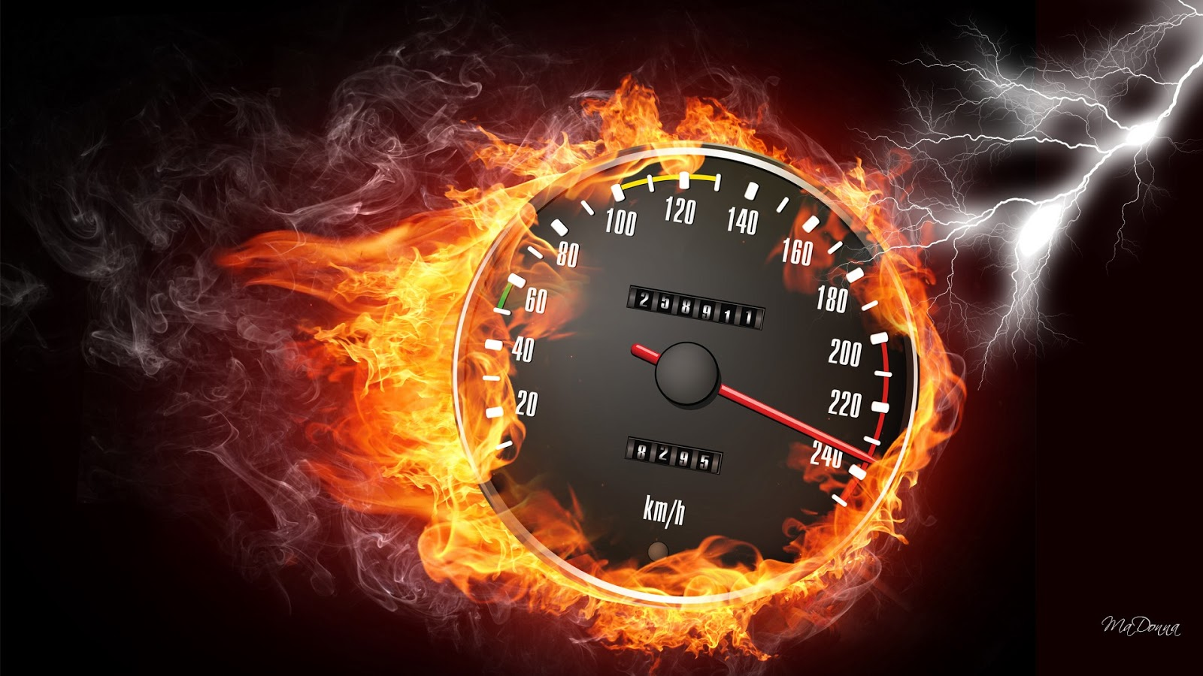
Cons of python
Fewer seasoned developers (although this number is growing rapidly)
Lack of true multiprocessor support
Speed limitations
Not the go-to language for mobile app development
Not ideal for memory-intensive tasks
Design restrictions
https://djangostars.com/blog/python-web-development/

Slide 9
PYTHON SYNTAX OVERVIEW

Slide 10
Python in action
Vending Machine
Text-based Maze Game

Slide 11
questions?

